Slide 1
5/26/15
Admit Slip
Describe a time you saw two organisms interacting in nature.
Which one was benefitting from the interaction and why?
Date: | 5/26/15 | Topic: | Symbiotic Relationships | Page # ___

Slide 2
Today in Room 315…
Date: | 5/26/15 | Topic: | Symbiotic Relationships | Page # ___
ADMIT SLIP: Describe an interaction b/w two organisms
HW: Draw an image of a symbiotic relationship w/ a description of the interaction and why you classified it**
CONTENT OBJ: SW identify types of symbiotic relationships
LANG. OBJ: SW define mutualism, predation, parasitism, commensalism, and competition in writing
ANNOUNCEMENTS: Missed Fri test? MUST TAKE TODAY!!!
AGENDA:
Symbiotic relationships video/worksheet
Record new vocab words
“Good Buddies” competition
EXIT SLIP: All scraps thrown away and room clean!

Slide 3
HOMEWORK PREP: Right now, go to the next blank page in your journal and create this “worksheet” so you will not forget to do it for homework!!
Symbiotic Relationship:
_____________________
Description/Explanation:
________________________
________________________________________________________________________________________________

Slide 4
Symbiotic Relationships
*Symbiosis: An interaction between two different organisms living in close physical association
Admit slip share out?

Slide 5
Symbiotic Relationship Videos
Watch each segment from this website: http://education.nationalgeographic.com/education/activity/ecological-relationships/?ar_a=1
Fill in associated worksheet

Slide 6
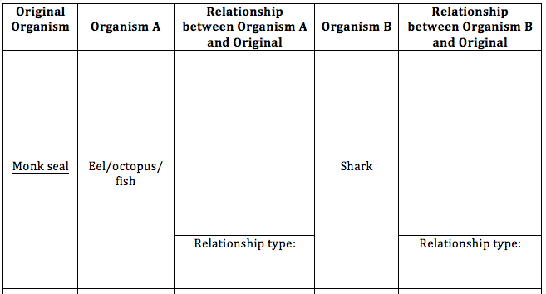

Slide 7
Symbiotic Relationships*
Now, label your worksheet!!
+/-?
Predation = One organism feeds on another
Competition = When two or more organisms compete for the same food source
Mutualism = Both organisms benefit from the actions of the other
Commensalism = One organism benefits, the other organism does not benefit but is unharmed
Parasitism = One organism feeds off another (parasite benefits and host is harmed)

Slide 8
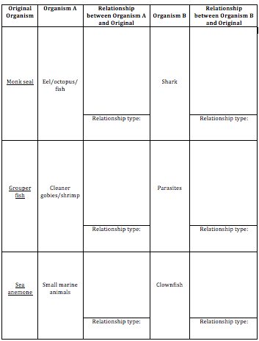

Slide 9
“Good Buddies” Competition
Bring up worksheet post description
In teams of TWO, you will compete against each other to see who can first complete the activity correctly (winning team gets candy prize)
You must match the original organism to its symbiotic partner (aka which organisms are interacting), along with the correct description and relationship
Each box will be filled; only one correct answer

Slide 10
Clean up!!
All materials away
Throw away scraps
Nothing on the floor
If your sheet is wet with glue you may leave it here to dry
Otherwise, tape into journal or put away for safe keeping

Slide 11
Admit Slip
5/26/15
On one full page, create this chart in your journal:
Symbiotic Relationship #1
Symbiotic Relationship #2
5 Interesting Facts:
Description:
Description:
1.
2.
3.
4.
5.
Relationship:
Relationship:
Date: | 5/26/15 | Topic: | Symbiotic Relationships | Page # ___

Slide 12
Volcanoes of the Deep Sea
http://www.hulu.com/watch/380236

