Slide 1
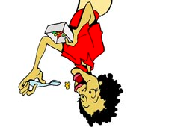
1/14/15
Admit Slip
In your journal, answer these questions:
Can you eat food upside-down? How would food reach your stomach if gravity exists?
Make sure your one paragraph is out so I can give you homework credit!
Date: | 1/14/15 | Topic: | Process of Digestion | Page # ___

Slide 2
Today in Room 315…
Date: | 1/14/15 | Topic: | Process of Digestion | Page # ___
ADMIT SLIP: Can you eat upside-down?
HW: Write another paragraph
CONTENT OBJ: SWBAT explain the path of food through the digestive system LANG. OBJ: SW fill in guided notes
ANNOUNCEMENTS: Marathon & Test on Fri 23rd
AGENDA:
Discuss AS
Watch video & complete guided notes EXIT SLIP: Any questions??

Slide 3
Admit Slip Discussion
Can you eat upside-down??

Slide 4
Digestion Video
Follow along with guided notes

