Slide 1
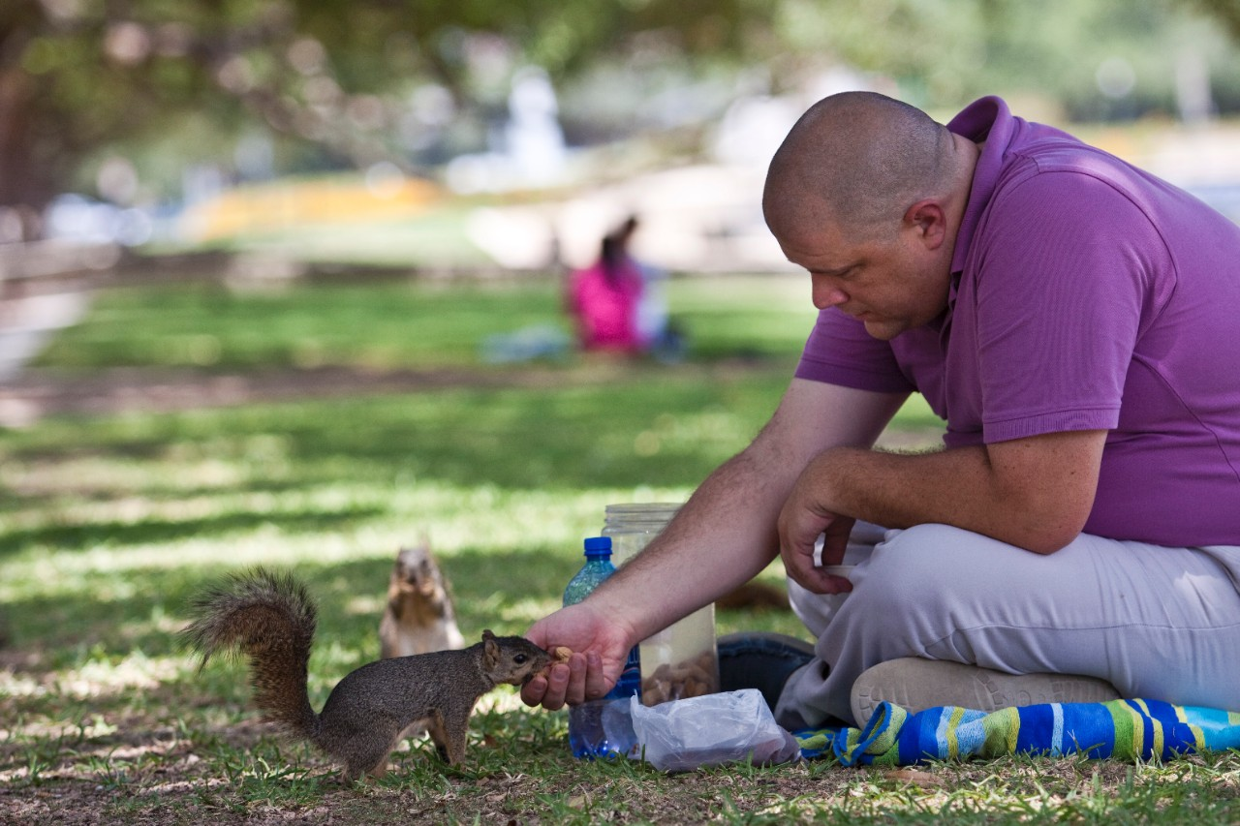
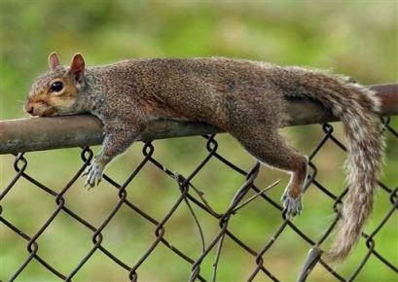
Mr. Love???
6/5/15
Admit Slip
There is a population of squirrels living in the area surrounding TBA.
List at least five factors that may affect the size of their population.
Date: | 6/5/15 | Topic: | Population Change | Page # ___

Slide 2
Today in Room 315…
Date: | 6/5/15 | Topic: | Population Change | Page # ___
ADMIT SLIP: Factors affecting squirrel population
HW: STUDY!!
CONTENT OBJ: SW use data to draw conclusions about the relationship between wolves and deer LANG. OBJ: SW answer analysis questions in writing
ANNOUNCEMENTS: Ecology Test on MONDAY!
AGENDA:
Factors that affect population
Word Review
Wolves Video
Deer population worksheet
EXIT SLIP: Turn in your classwork!!

Slide 3
Factors that increase pop. size*
Birth rate
Number of individuals born compared to the overall population number (%)
Immigration
Migration of an individual into the population (moving into a new space)
THINK: Why does immigration not affect the size of the world’s human population?

Slide 4
Factors that decrease pop. size*
Mortality or death rate
# of individuals that die compared to the overall population
Usually in reference to age groups
Ex. 2010 infant mortality in US = 0.6%
Emigration
Migration of an individual away from the population to a different space

Slide 5
Factors affecting increase/decrease factors*
Predation → death rate OR birth rate/ immigration or emigration
Food availability → immigration/emigration/ death rate/birth rate
Could lead to starvation, OR surplus = increase
Shelter availability → i/e/dr/br
Anything else?

Slide 6
Vocab Check
Heterotroph vs. autotroph*
Heterotroph = eats OTHERS to obtain energy (most animals)
Autotroph = creates its own food for energy (plants)
Trophic level*
Position an organism occupies in a food chain
Ex. Producer, primary consumer, secondary consumer, etc.

Slide 7
How Wolves Change Rivers
Thoughts??
Video: https://www.youtube.com/watch?v=ysa5OBhXz-Q
Ecosystem engineers*
Organisms that build, modify, or destroy parts of the environment that affect the abundance and diversity of other species (Ex. beavers)

Slide 8
Succession*
Succession is a change in the structure and make up of the living parts of a community over time
Just like the video showed… change in the living parts over time (wolves → lots of changes)
Usually begins with a disruption (fire, volcano eruption, massive flood, etc.)
Environment progresses until it reaches a climax community = stable community

Slide 9
Primary vs. Secondary Succession*
http://www.mrphome.net/mrp/succession.swf

Slide 10
Deer: Predation or Starvation
Read together
(Class discussion if time allows)

