Slide 1
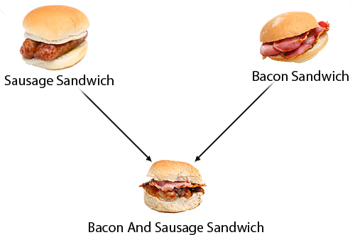
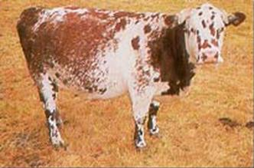
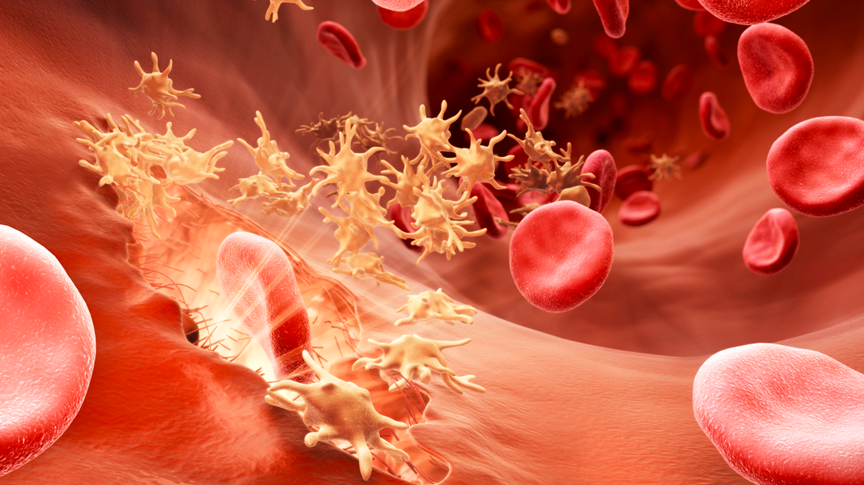
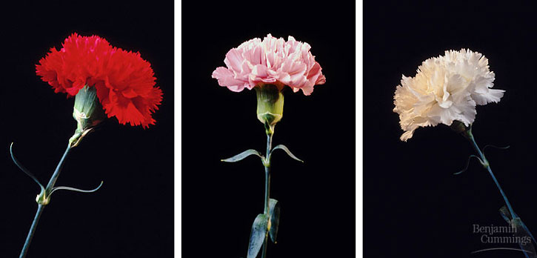
4/6/15
Admit Slip
In journal, name all the inheritance patterns we have worked with so far
Date: | 4/6/15 | Topic: | Pedigrees | Page # ___

Slide 2
Today in Room 315…
Date: | 4/6/14 | Topic: | Pedigrees | Page # ___
ADMIT SLIP: List inheritance patterns
HW: Genetics Practice Problems: Pedigree Tables
CONTENT OBJ: SW use pedigrees to determine inheritance patterns
LANG. OBJ: SW explain their reasoning through writing ANNOUNCEMENTS: Test on Thursday!!
AGENDA:
Pedigree notes
Pedigree class practice
Pedigree individual practice
EXIT SLIP: Ask questions!!

Slide 3
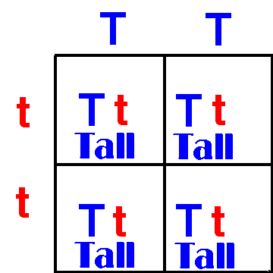
Inheritance Patterns
Normal dominant/recessive
Incomplete dominant
Codominant
X-linked

Slide 4
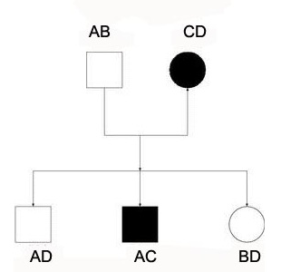
Pedigrees*
“Record of ancestry”
An inheritance chart that allows you to see which members of a family are affected by a specific trait
Helps you to determine their genotypes
Square = male, Circle = female
Assume people marrying into the family are NOT carriers for the trait (assume homozygous)

Slide 5
Pedigree Analysis
Options:
Autosomal recessive
Autosomal dominant
X-linked
Which inheritance pattern is it?
Which allele is the dominant allele?
Pedigree Hints!! **
- Dominant = many people affected by trait
- Recessive = few people affected by trait
- X-linked = mostly males affected by trait

Slide 6
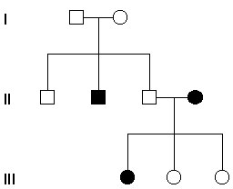
Solving…*
Options
1. Write list
2. Make observations
3. Use trial and error
Notes:
Autosomal recessive

Slide 7
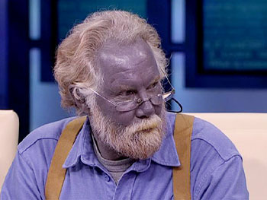
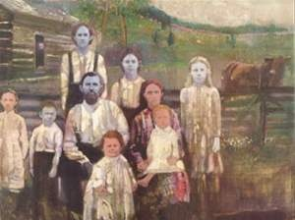
Blue Family of Kentucky
Benjamin Stacy, born 1975, is the last known descendant of Fugate family with blue skin.
Fugate family lived in the hills of Kentucky
Several family members carried genetic trait for the disease “methemoglobinemia”
Results in blue skin

Slide 8
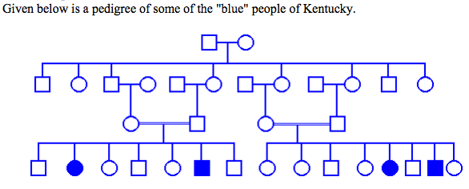
Why did they have blue skin??
Notice anything strange?? Remember a line between two shapes = they had children together
What type of inheritance pattern is this? (Remember your hints from before!)
Notes:
Autosomal recessive

Slide 9
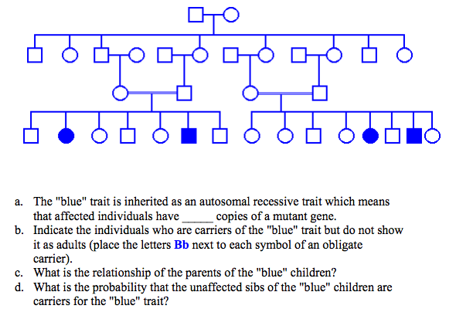
d
Try to answer these questions on your own using the worksheet!
Notes:
Pass out “How to solve pedigrees” to students(pg 1 & 2, double sided), have pg 3 available to take home

Slide 10
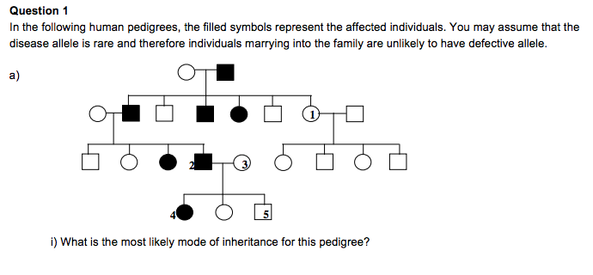
Step 1: Write Options
Step 2: Observations
3. Try it out!
Notes:
Autosomal dominant

Slide 11
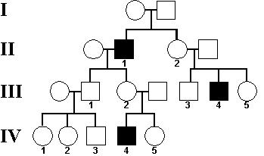
Inheritance Pattern?
What do you notice???
Notes:
X-linked

Slide 12
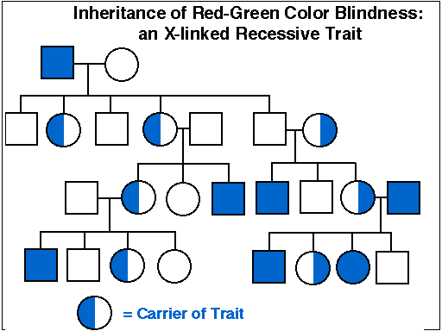

Slide 13
Practice Problems
Complete the packet titled “Genetics Practice Problems: Pedigree Tables”
You may work in pairs if you wish, as long as you are productive
If you do not finish, you must finish the packet for homework in addition to the homework sheet
Work work work!

