Slide 1
5/12/15
Admit Slip
List everything you think of when you hear the word, “mutant”
Get out your homework!
-Admit slip re-do
-Protein synthesis worksheet
Date: | 5/12/15 | Topic: | Mutations | Page # ___

Slide 2
Today in Room 315…
Date: | 5/12/15 | Topic: | Mutations | Page # ___
ADMIT SLIP: What does “mutant” mean to you?
HW: Finish classwork
CONTENT OBJ: SW identity types of mutations in a DNA base sequence, and their effect on the protein
LANG. OBJ: SW explain each type of mutation in writing
ANNOUNCEMENTS: Back to normal tomorrow!
AGENDA:
Admit slip share out
Mutation Notes
Mutation Practice
EXIT SLIP: Explain one type of mutation

Slide 3
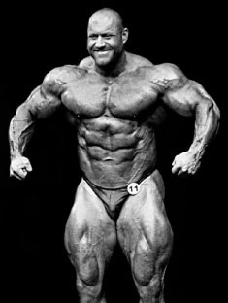
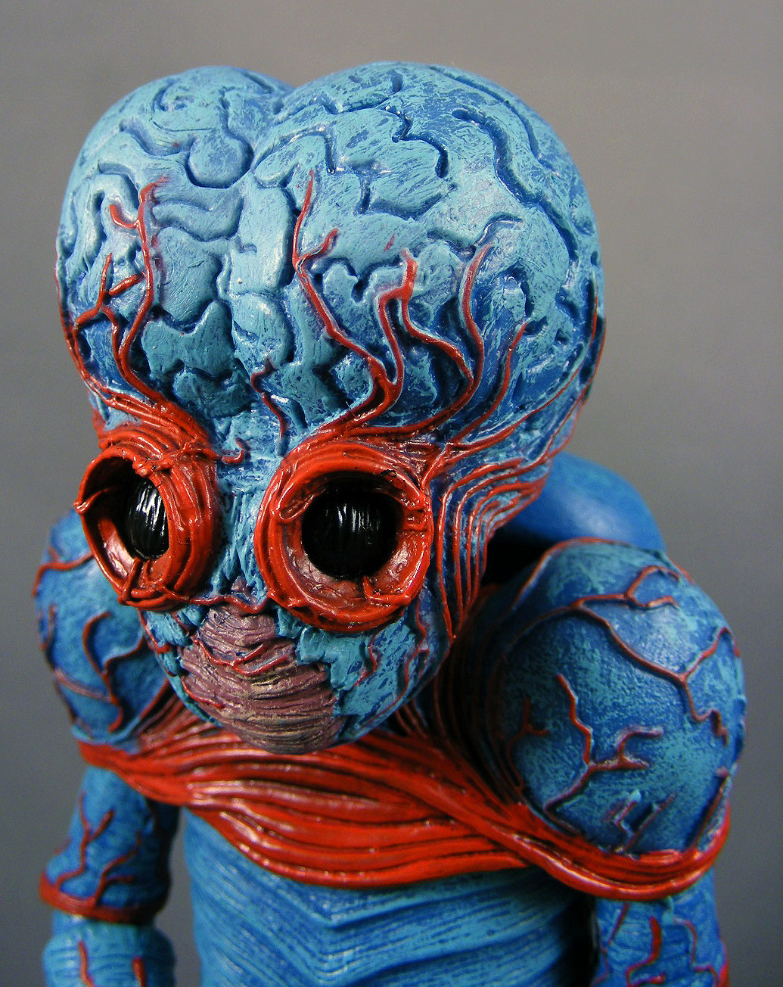
Admit Slip Shareout

Slide 4
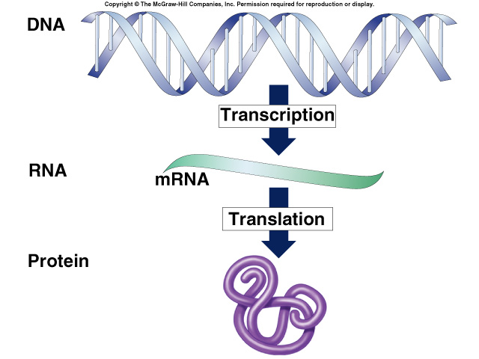
Recall: Central Dogma

Slide 5
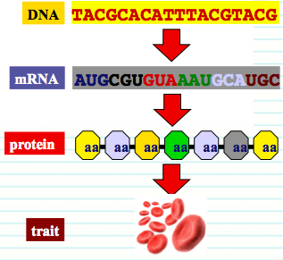
Mutations*
Changes in the DNA sequence
Leads to changes in the mrNA
May change protein
May change trait

Slide 6
Types of Mutations*
Point mutation
Change to ONE letter (base) in the DNA
May cause change to protein, may not
Frameshift mutation
Addition of a new letter (base) in DNA, or
Deletion of a letter (base) in DNA
Both types shift the DNA frame (changes codons)
Big changes to protein!

Slide 7
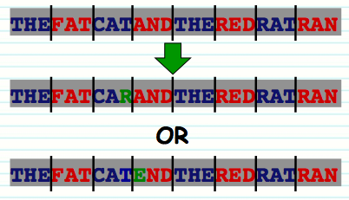
Point Mutation Example
(one base change)

Slide 8
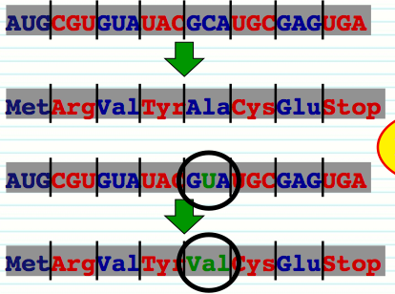
Types of Point Mutations*
Missense mutation
Changes amino acid
Example:
GCA → Ala
But if mutation occurs and GCA becomes GUA
GUA → Val

Slide 9
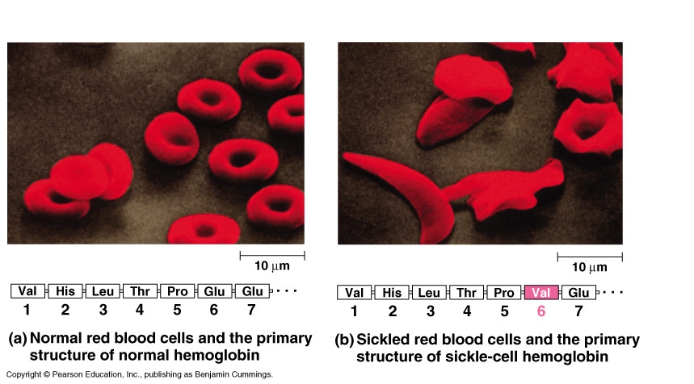
Missense Mutation Ex.*
Sickle Cell Anemia*
Sickle Cells
Normal red blood cells

Slide 10
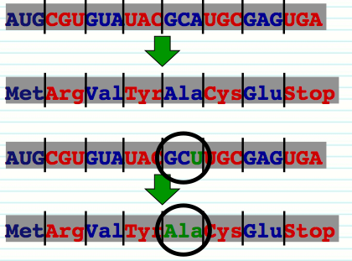
Types of Point Mutations
Silent mutation* = no change to protein
If there is a change in the base code, why doesn’t the protein switch?

Slide 11
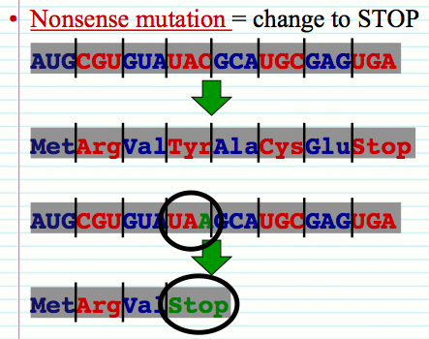
Types of Point Mutations
Nonsense mutation* = change to STOP
Protein ends up much shorter than intended (fewer amino acids)

Slide 12
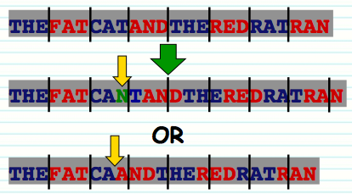
Frameshift Mutations
Frameshift: Add or delete one or more bases

Slide 13
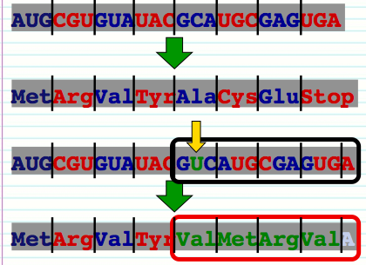
Types of Frameshift Mutations*
Insertion = add one or more base
How much does it change the protein?
A lot!

Slide 14
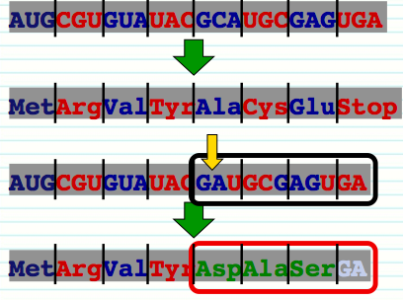
Types of Frameshift Mutations*
Deletion = lose one or more bases
How much does this change the protein?
A lot!

Slide 15
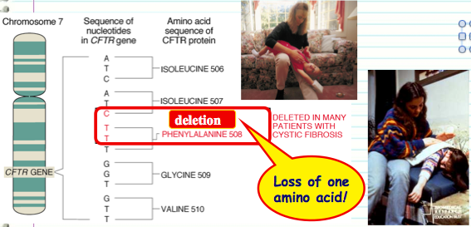
Deletion Example*
Cystic Fibrosis*

Slide 16
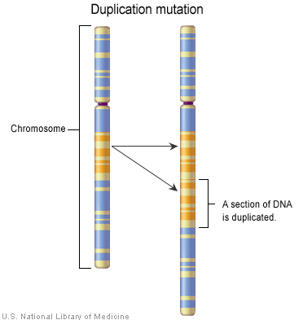
Duplications*
Duplications = doubling a section of DNA
May be beneficial
Over time may lead to new functions

Slide 17
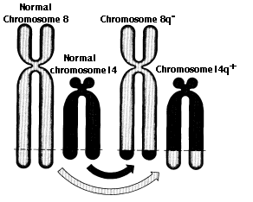
Translocations*
Transfer of a piece of one chromosome to a non-homologous chromosome
The two nonhomologous chromosomes often swap segments (reciprocal)

Slide 18
Practice
Complete worksheet (read the directions!!)

Slide 19
5/12/15
Admit Slip
Complete the Mutation Practice Questions handout
Get out your homework!
-Admit slip re-do
-Protein synthesis worksheet
-Mutations worksheet
Date: | 5/12/15 | Topic: | Mutations practice | Page # ___

Slide 20
Today in Room 315…
Date: | 5/12/15 | Topic: | Mutations practice | Page # ___
ADMIT SLIP: Mutant Practice Questions
HW: Finish classwork if needed
CONTENT OBJ: SW summarize key points in a reading on mutations
LANG. OBJ: SW orally present their findings to their group
ANNOUNCEMENTS: Back to normal tomorrow!
AGENDA:
Check & Review HW
Review Admit Slip
Reading/notes
Presentations
EXIT SLIP: Summarize your learning of other groups

Slide 21
Review Homework/Admit Slip

