Slide 1
1/7/15
Admit Slip
In your journal, write a one paragraph summary of the food lab conducted yesterday, and why you think we did it.
Date: | 1/7/15 | Topic: | Food Lab Review | Page # ___

Slide 2
Today in Room 315…
Date: | 1/7/15 | Topic: | Food Lab Review | Page # ___
ADMIT SLIP: Write a summary of food lab
HW: Lab Packet due TOMORROW
CONTENT OBJ: SW discuss takeaway of food lab
LANG. OBJ: SW answer lab questions in writing
ANNOUNCEMENTS: Unit Test on Fri!!
AGENDA:
Lab summary
Review questions
Fill out lab packet
EXIT SLIP: Complete at least 3 questions from packet

Slide 3
Nutrients Tested
What were the 5 tests we conducted testing for?
Which ones did you enjoy the most? Which surprised you the most?
Notes:
Brief discussion

Slide 4
+ and - Controls
What are they?? (Let’s answer the question on the first page of the packet…)
Positive control = shows what the solution should look like in the PRESENCE of a substance
Negative control = shows what the solution should look like in the ABSENCE of a substance

Slide 5
Predictions?
Were they accurate?
How did you make your predictions?

Slide 6
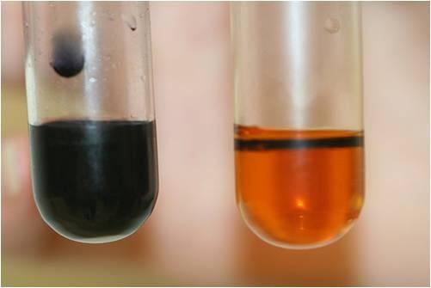
Natural Color
How would the color of the food affect the test??
Think: Oreo

Slide 7
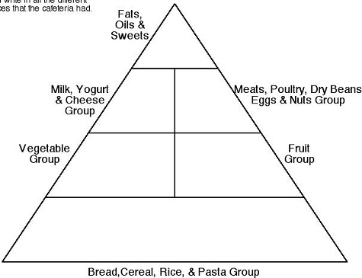
What’s a “food pyramid?”

Slide 8
Takeaway
What is YOUR takeaway from this lab?
Why did we do it??

Slide 9
Lab Packet- due THURS
Work on questions now

