Slide 1
5/8/15
Admit Slip
Complete the admit slip handout.
Get out your enzyme flashcards!
Date: | 5/8/15 | Topic: | Transcription/Translation | Page # ___

Slide 2
Today in Room 315…
Date: | 5/8/15 | Topic: | Transcription/Translation | Page # ___
ADMIT SLIP: DNA Replication review handout
HW: Transcription/Translation handout CONTENT OBJ: SW transcribe and translate a DNA sequence into mRNA and amino acids LANG. OBJ: SW verbally explain the concepts
ANNOUNCEMENTS: DO YOUR HOMEWORK! (Only 15 min!)
AGENDA:
Finish Replication notes
Review admit slip
Quiz
Transcription/Translate
EXIT SLIP: Translate and Transcribe a gene

Slide 3
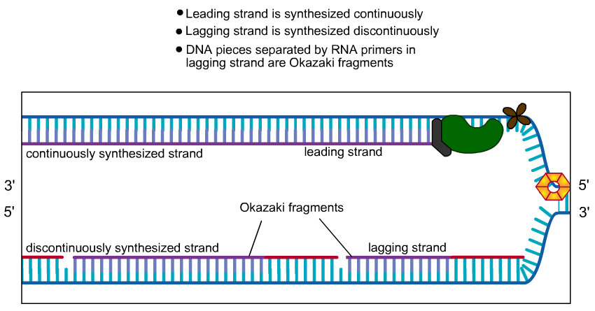
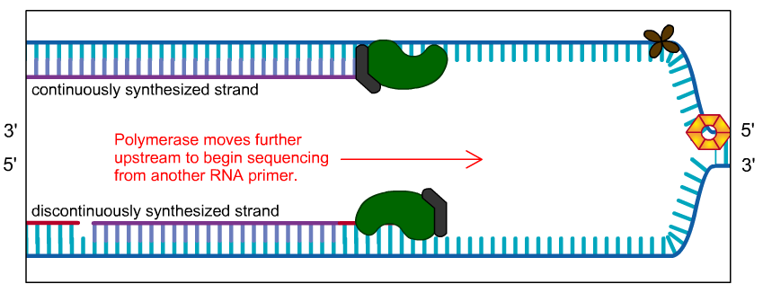
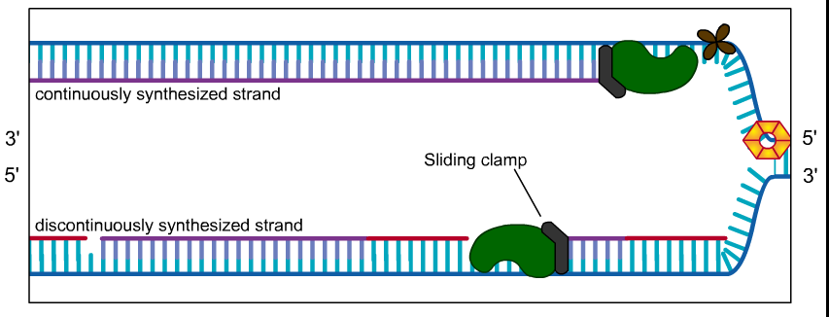
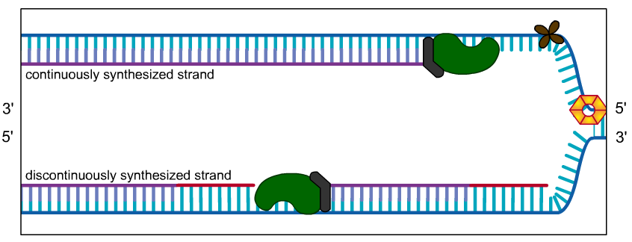
Continuous vs. Discontinuous*

Slide 4
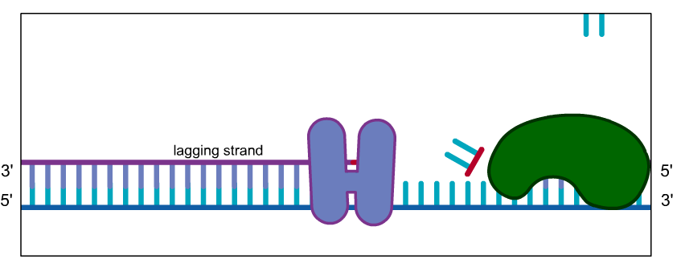
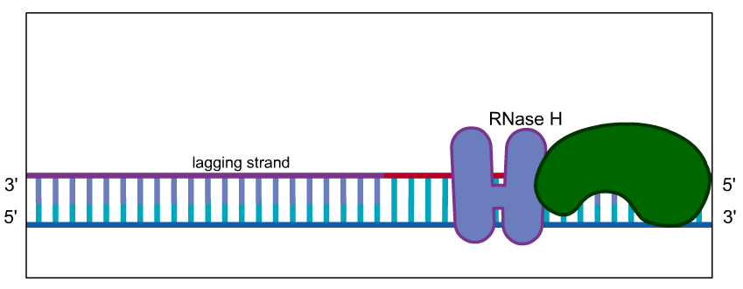
5th Step*

Slide 5
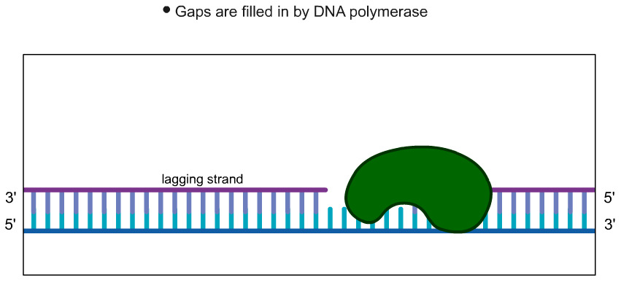
6th Step*

Slide 6
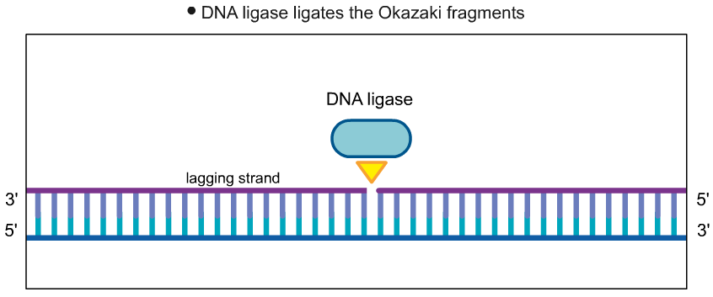
7th Step*

Slide 7
Admit Slip Review

Slide 8
Quiz Time!
Any questions??

Slide 9
DNA Replication*
Process through which DNA is copied by DNA polymerase to produce a complementary DNA strand

Slide 10
Transcription*
Process through which DNA is copied by RNA polymerase to produce complementary RNA strand

Slide 11
Translation*
Process by which an RNA strand is read by a ribosome and each codon is turned into an amino acid

Slide 12
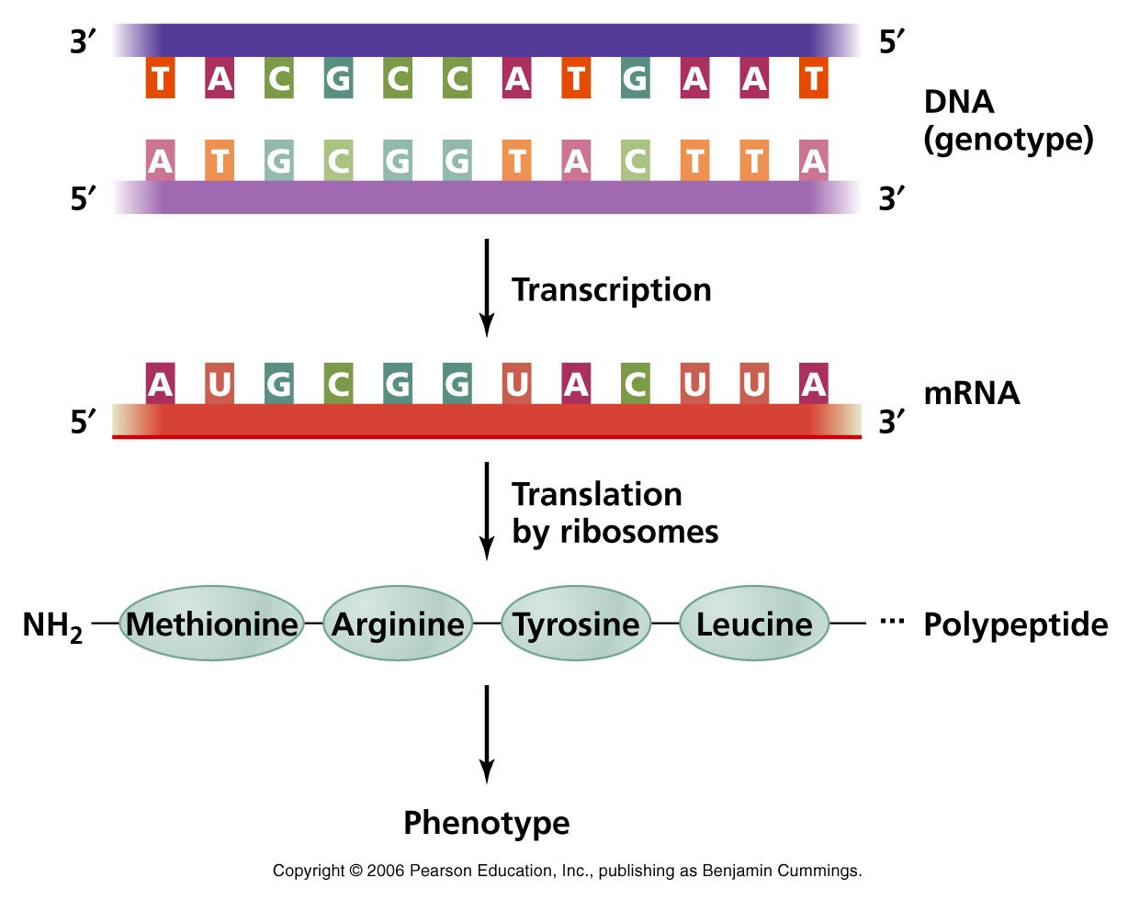
Central Dogma

Slide 13
“Central Dogma” *
Flow of genetic information from gene to trait
Trait = Combination of proteins (leading to structure)
Gene = segment (piece) of DNA

Slide 14
Locations*
DNA Replication occurs in the nucleus
Transcription occurs in the nucleus
Translation occurs in the cytoplasm

Slide 15
DNA Transcription*
Gene sequence is copied into messenger RNA (mRNA)
mRNA has 4 nucleotide bases like DNA, but instead of Thymine (T) it has Uracil (U)
Produces a single strand of mRNA
Process of DNA → RNA

Slide 16
Transcribe the DNA

Slide 17
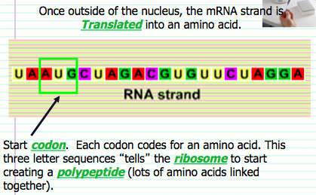
Translation*

Slide 18
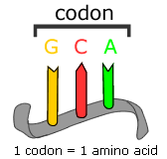
Codons*
Each codon = 1 amino acid
Codon = 3 bases (letters)
There are 20 amino acids, but most amino acids have several codons that “code” for it

Slide 19
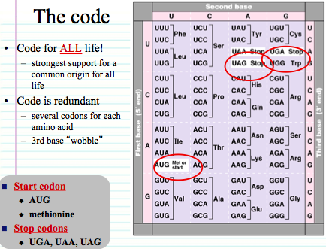
Pass out personal code wheels!***

Slide 21
Homework!
Turn DNA to RNA to Amino Acid (Protein)
Use “codon wheel” to solve the code!

Slide 22
5/11/15
Get out your homework!
Admit Slip
Why is DNA often considered “the code of life”?
Date: | 5/11/15 | Topic: | Code of Life | Page # ___

Slide 23
Today in Room 315…
Date: | 5/11/15 | Topic: | Code of Life | Page # ___
ADMIT SLIP: Why is DNA the code of life?
HW: Re-answer the admit slip & Finish class handout (Protein Synthesis worksheet)
CONTENT OBJ: SW transcribe and translate a DNA sequence into mRNA and amino acids LANG. OBJ: SW explain in writing why DNA is the code of life
ANNOUNCEMENTS:
AGENDA:
Homework Review
Transcription/Translation Notes
Video
Online practice (class)
EXIT SLIP: Translate and Transcribe a gene

Slide 24
Homework Check
Put up answer key

Slide 25
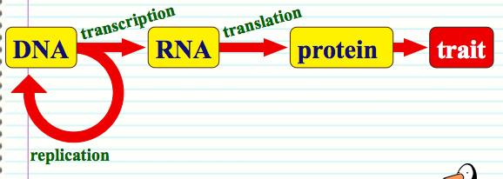
DNA as the “Code of Life” *
Central Dogma!!
This will be an open response question!!
A transcript of DNA bases (A, T, C, G) codes for RNA
A transcript of RNA bases (A, U, C, G) codes for a protein chain
Proteins interact to create physical characteristics (traits)

Slide 26
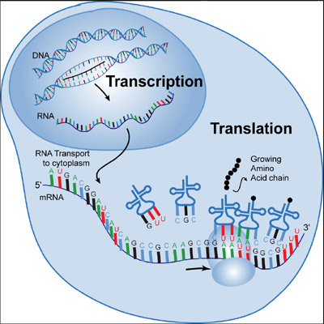

Slide 27
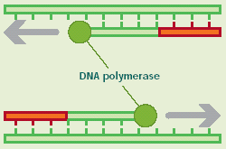
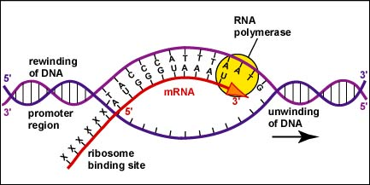
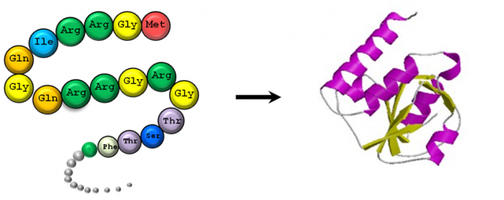
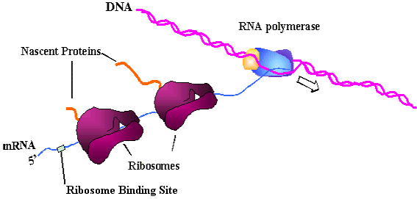
Machinery*
Reads the DNA template strand to create a complementary DNA strand __________________
Reads the DNA template strand to create a complementary RNA strand __________________
Reads the RNA strand to create the corresponding amino acids __________________

Slide 28
Ribosome*
Draw this!!!
“Protein factory”
3 binding sites:
A, P, E
Attaches to mRNA (messenger RNA)
Creates polypeptide chain (linked amino acids)

Slide 29
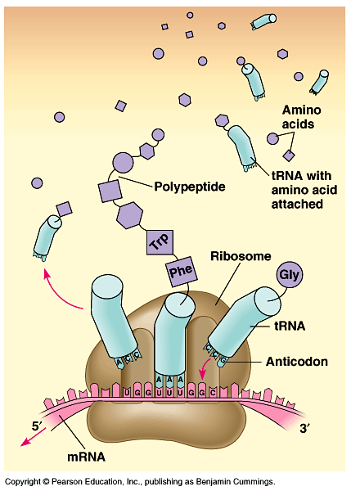
Building a Polypeptide*
tRNA (transfer RNA) holding amino acid attaches at A site
tRNA moves to P site; amino acid attaches to growing chain
Now empty tRNA moves to E site, lets go
3
2
1
Label the 1, 2, 3 on your first drawing

Slide 30
Start and Stop*
Ribosome only begins translation when it finds the start codon “AUG”
Ribosome stops translating when it hits a stop codon such as UAA, UAG, or UGA
Polypeptide chain is released → folds to form a protein

Slide 31
Video Overview
https://www.youtube.com/watch?v=41_Ne5mS2ls

Slide 32
Class Practice!
Translate and Transcribe a Gene
http://learn.genetics.utah.edu/content/molecules/transcribe/

Slide 33
Vocab Review!! (*)
Look below, any questions???
Transcript
Template
DNA vs mRNA vs tRNA
Codon
Ribosome
Polypeptide

Slide 34
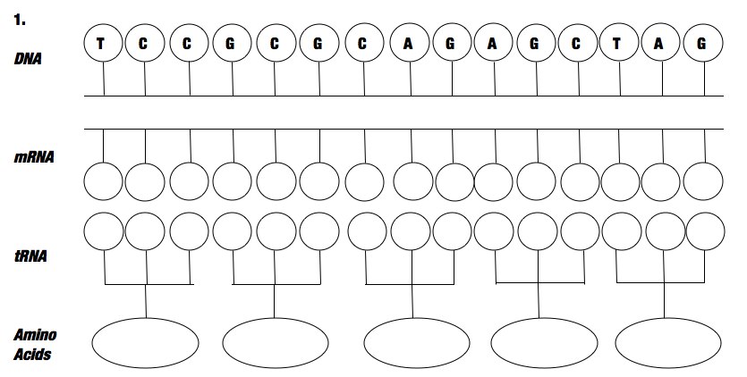
Individual Practice!

