Slide 1
Get out your Anorexia handout to be collected & your digestion packed to be checked!!
1/22/15
Admit Slip
In your journal, show your work…
If Ms. Gately consumes 5g of food containing carbs & protein, and Mr. Louis consumes 4g of pure fat, who has consumed more calories?
1g carb = 4 Calories
1g fat = 9 Calories
1g protein = 4 calories
Date: | 1/22/15 | Topic: | Ch. 7 Review Day | Page # ___

Slide 2
Today in Room 315…
Date: | 1/22/15 | Topic: | Ch. 7 Review Day | Page # ___
ADMIT SLIP: Energy math problem
HW: Finish Marathon, STUDY for test!!
CONTENT OBJ: SW study chapter 7 content
LANG. OBJ: SW write out study guides ANNOUNCEMENTS: Marathon due & Chapter 7 test tom.!
AGENDA:
Discuss admit slip (math)
Study guide how-to
Students make study guides
Work on marathon assignment if time
EXIT SLIP: Any questions for tomorrow??

Slide 3
Admit Slip Review
You need to know this for the test!

Slide 4
Today
Create-your-own Review Packet
14 components to know for tomorrow
Write out all information in your journal (use your worksheets/notes!)
Writing out information is a GREAT way to study → leads to increased retention (memory)
Complete review packet = +3 points on test

Slide 5
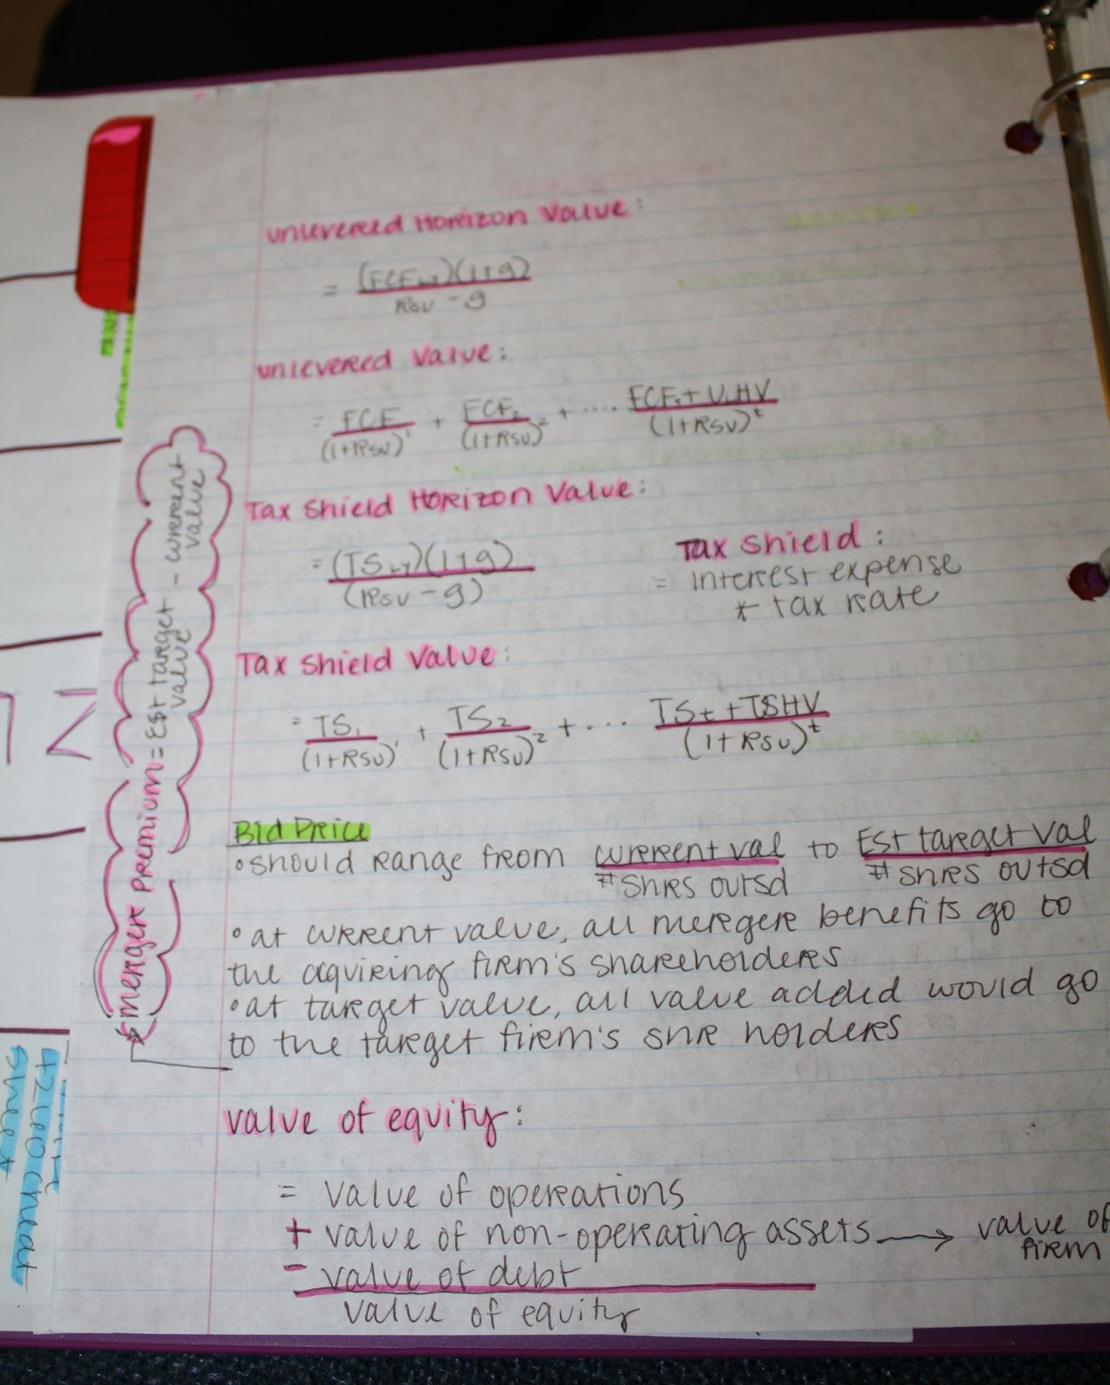
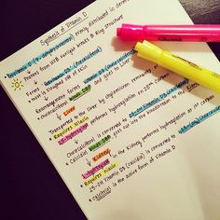
Study Guide: How-to
Write heading (underline or highlight)
Make bullets with relevant information
Write notes
Draw graphs or images as needed

Slide 6
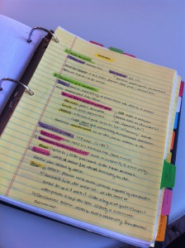
Study Guide: How-to Example

Slide 7
Today’s Goals
WARNING: The test has many fill-in/open response questions. You MUST study if you hope to pass.
Create study guide with all 14 components
If (and only if!) you completely finish, you can work on your marathon assignment
REMEMBER…
Marathon packet & essay due tomorrow AT THE START (it is a long test and you do not want to waste time printing- come during homeroom if necessary!)
Chapter 7 Test tomorrow (DO NOT COME LATE!)

